Slide 1
TOPIC MODELING USING BIG DATA ANALYTICS
-BY
SARAH MASUD(12-CSS-57)
FARHEEN NILOFER(12-CSS-23)

Slide 2
INTRODUCTION
WORK FLOW:
Installation of Hadoop on multiple nodes- For distributed processing.
Pre processing of data set - Cleaning and conversion of data into desired format.
Passing the converted data to the modeling tool.
Parallelizing the computation and algorithm selection.
Comparison of results on the basis of
Efficiency of different modelling algorithms
Computation on single vs multiple node.

Slide 3
WHAT Is Big Data and Topic Modelling?
Big Data:
Data that cannot be stored or processed by traditional computing techniques.
EXAMPLES: Black Box Data, Social Media, Space Exploration, Power and Grid Station,Search Engine Data…
Topic Modelling:
Topic models are a suite of algorithms that uncover the hidden thematic structure in document collections.
IN LAYMAN TERMS
A method of text mining to identify patterns in a corpus. Topic modeling helps us develop new ways to search, browse and summarize large archives of texts.
VOLUME
VARIETY
VELOCITY

Slide 4
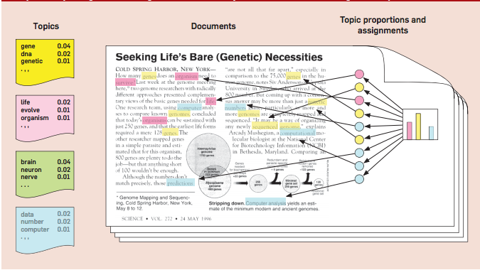
TOPIC MODELING IN IMPLEMENTATION

Slide 5
WHY Topic Modelling using Big Data ?
You have to create several different variables for every single word in the corpus. The models we would be running, with roughly 2,000 documents, will get to the edge of what can be done on an average desktop machine, and commonly take a day.
Hadoop is a framework which could provide all the facilities that are needed in modelling of such a huge set of data.
5 MILLION GIGABYTES OF DATA GENERATED(amount)
2015
2013
??
10 MINS
2011
2003
2 DAYS
till

Slide 6
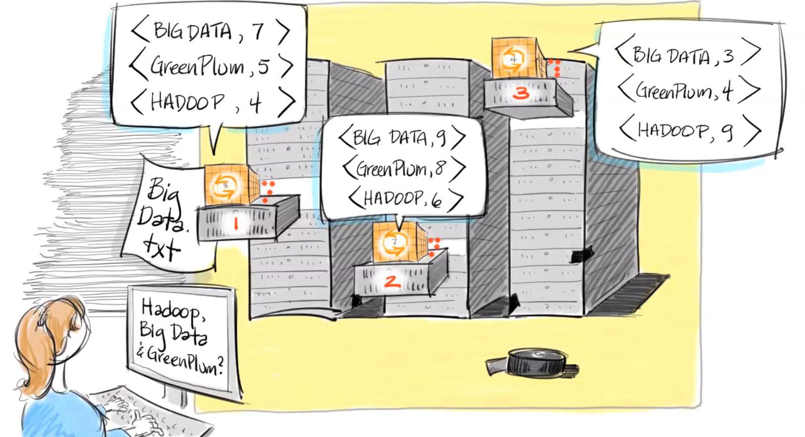
HADOOP and its COMPONENTS
Hadoop:
An open source framework written in JAVA.
It is designed to scale up from single servers to thousands of machines, each offering local computation and storage.(confi)
It has two major component-
HDFS(Hadoop Distributed File System)- For the storage.
MapReduce- Processing of data.(pgram model)
Hadoop Installation:
Cluster of 5 (in our case) commodity hardwares.
Namenode-the manager.
Datanodes- the actual storage and processing units.

Slide 7
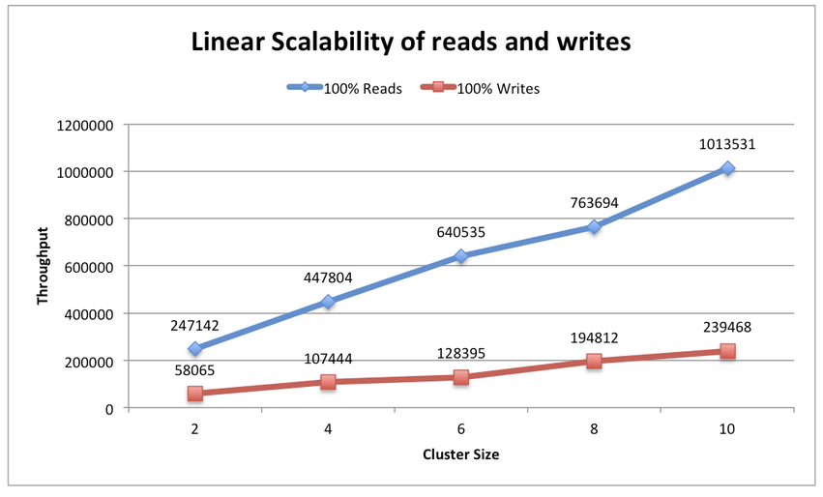
COMPARISON OF EXECUTION TIME

Slide 8
HOW Topic Modelling is Achieved Using Big Data Analytics?
Proposed Algorithms:
Probabilistic Latent Semantic Indexing ( PLSI) :
It is a novel statistical technique for the analysis of two-mode and co-occurrence data
Latent Dirichlet allocation (LDA):
It’s a way of automatically discovering topics that sentences contain.
Pachinko allocation
Modeling correlations between topics in addition to the word correlations which constitute topics.
`
d
w
z

Slide 9
HOW Topic Modelling is Achieved Using Big Data Analytics?
TOPIC MODELLING TOOLS
TOOLS | Model/Algorithm | Language | Introduction
Mallet | LDA(including Naïve Bayes, Maximum Entropy, and Decision Trees) | Java | efficient routines for converting text to "features", a wide variety of algorithms
lda | R package for Gibbs sampling in many models | R | Implements many models and is fast
hdp | Hierarchical Dirichlet processes | C++ | Topic models where the data determine the number of topics. This implements Gibbs sampling.

Slide 10
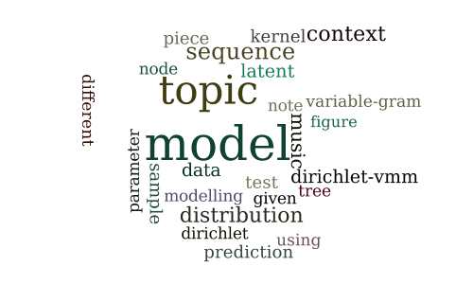
WHERE is Topic Modeling Using Big Data Applied?
SOME APPLICATIONS OF TOPIC MODELING INCLUDE:
Topic Modeling for analyzing news articles.
Topic Modeling for Page Rank in Search Engines.
Finding patterns in genetic data, images, social graphs.
Topic modeling on historical journals.

Slide 11
REFERENCES:
Papadimitriou, Christos; Raghavan, Prabhakar; Tamaki, Hisao; Vempala, Santosh (1998). "Latent Semantic Indexing: A probabilistic analysis" (Postscript). Proceedings of ACM PODS.
Blei, David M.; Ng, Andrew Y.; Jordan, Michael I; Lafferty, John (January 2003). "Latent Dirichlet allocation". Journal of Machine Learning Research 3: 993–1022. doi:10.1162/jmlr.2003.3.4-5.993.
Blei, David M. (April 2012). "Introduction to Probabilistic Topic Models" (PDF). Comm. ACM 55 (4): 77–84. doi:10.1145/2133806.2133826.
Sanjeev Arora; Rong Ge; Ankur Moitra (April 2012). "Learning Topic Models—Going beyond SVD". arXiv:1204.1956.

